Slide 1

  Chapter Three
  Software Frameworks for Real-time and Embedded Systems

Slide 2

Module Outline
Real-time OS: definitions, Characteristics, functionality, structure and support for applications
Features of a RTOS
General and specific microprocessors
Inter process communication
Real time task scheduling
RTOS support for semaphores, queues, and events
Dynamic allocation of tasks
Scheduling: Cyclic scheduling, Priority-based scheduling
Multi-tasking and Concurrency issue
Fault- tolerance
Synchronization techniques: Centralized clock synchronization, Distributed clock synchronization
Handling resource sharing and dependencies

Slide 3
Real Time Operating System (RTOS)
OS is a system program that provides an interface between application programs and the computer system (hardware).
RTOS?
A RTOS is an OS that guarantees a certain capability within a specified time constraint.
The applications where dependability that a certain task will finish before a particular deadline is just as obtaining the correct results.
Besides meeting deadlines, RTOS must also be able to respond predictably to unpredictable events and process multiple events concurrently

Slide 4
Cntd…
RTOS is key to many embedded systems today and, provides a software platform upon which to build applications.
Not all embedded systems are designed with an RTOS. Some embedded systems with relatively simple hardware or a small amount of software application code might not require an RTOS.
Many embedded systems with moderate-to-large software applications require some form of scheduling, and these systems require an RTOS.
Although, some functional similarities exist between RTOS and General Purpose Operating System (GPOS), many differences occur as well.

Slide 5
Characteristics of a RTOS
RTOS generally have the following characteristics:
Small footprint. Compared to general OS, RTOS are lightweight.
High performance. RTOS are typically fast and responsive.
Determinism. Repeating inputs end in the same output.
Safety and security: Safety-critical and security standards are typically the highest priority, as RTOS are frequently used in critical systems.
Priority-based scheduling: Tasks that are assigned a high priority are executed first followed by lower-priority jobs.
Timing information: RTOS are responsible for timing and providing application programming interface

Slide 6
Cntd…
Some core functional similarities between a RTOS and GPOS
  Software and hardware resource management,
  Some level of multitasking
  Providing of underlying OS services to applications, and
  Abstracting the hardware from the software application
Some key functional differences that set RTOS apart from GPOS
  Better reliability in embedded application contexts
  The ability to scale up or down to meet application needs,
  Faster performance,
  Reduced memory requirements,
  Support for diskless embedded systems by allowing executables to boot and run from ROM or RAM, and
  Better portability to different hardware platforms

Slide 7
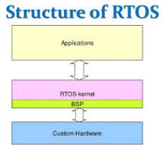
Structure of RTOS
Basic Structure is similar to regular OS but, in addition, it provides mechanisms to allow real time scheduling of tasks.
Though RTOSs may or may not increase the speed of execution, they can provide much more precise and predictable timing characteristics than general-purpose OS.

Slide 8
Cntd…
The heart of a real-time OS (and the heart of every OS) is the kernel.
A kernel is the central core of an OS, and it takes care of all the OS jobs:
  1. Booting
  2. Task Scheduling
  3. Standard Function Libraries
In an embedded system, frequently the kernel will boot the system, initialize the ports and the global data items.
Then, it will start the scheduler and instantiate any hardware timers that need to be started.
After all that, the Kernel basically gets neglected out of memory, and the scheduler will start running the child tasks.

Slide 9
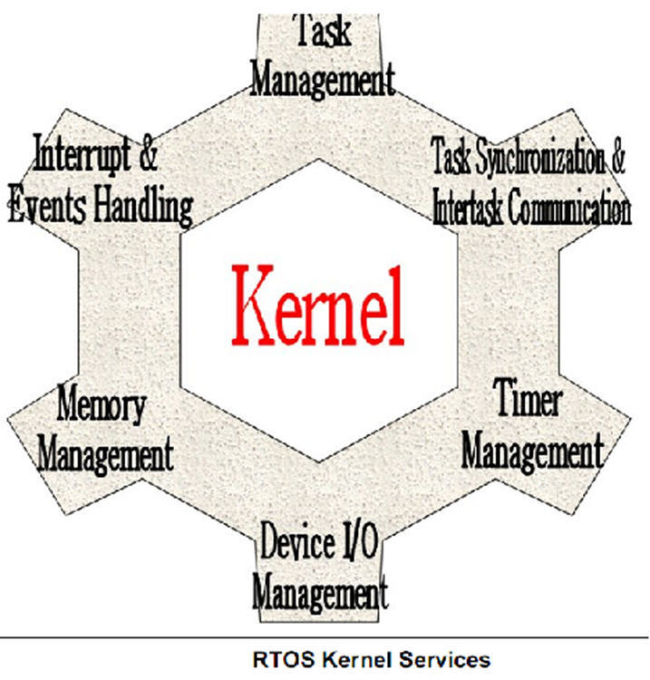
Basic Kernel Services
The "kernel" of a RTOS provides an "abstraction layer" that hides from application software from the hardware from details of the processor upon which the application software will run.
The Kernel provides
  An interrupt handler
  Task scheduler
  Resource sharing flags and
  Memory management

Slide 10
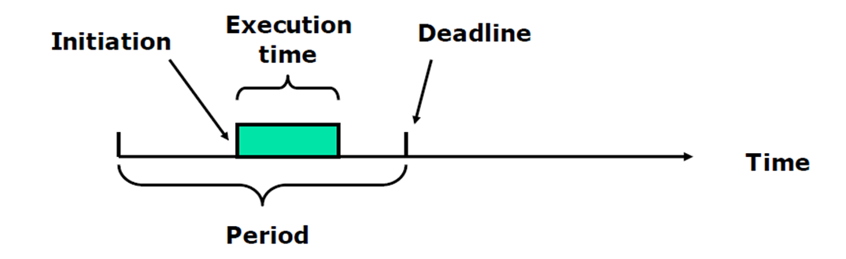
                Basic functions of RTOS
The following are some of the basic function of RTOS
  Task Management
  Interrupt handling
  Memory management
  Exception handling
  Task synchronization
  Task scheduling
  Time management
1. Task Management
  A task is a unit of execution or unit of work in a software application.
  Have timing constraints for tasks
  Each task a triplet: (execution time, period, deadline)
  Can be initiated any time during the period
Notes:
Tamper= interfere

Slide 11
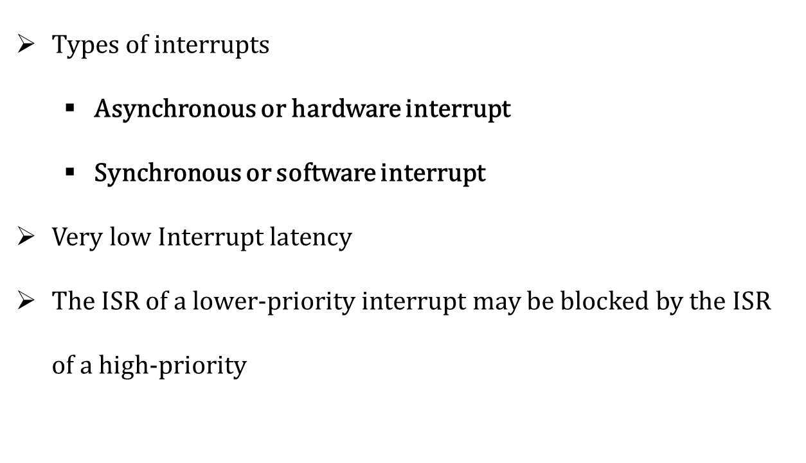
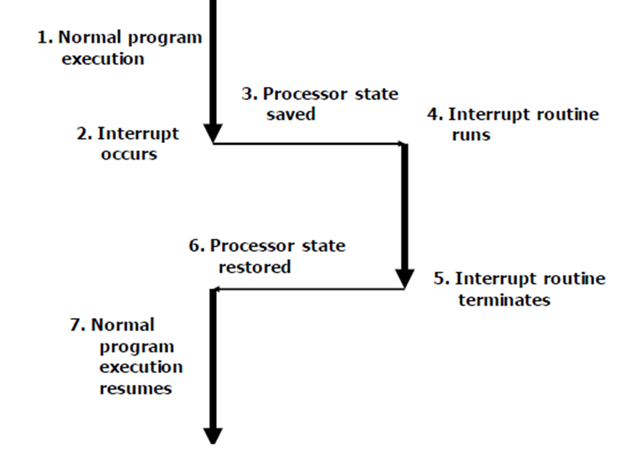
Cntd…
2. Interrupt handling
3. Memory management
When a task is created the RTOS simply returns an already initialized memory location.
when a task dies, the RTOS returns the memory location to the pool
4. Exception handling
Standard techniques:
  System calls with error code
  Fault-tolerance

Slide 12
Applications of RTOS
Real-time systems are used in:
  Airlines reservation system
  Air traffic control system
  Systems that provide immediate updating
  Defense application systems like RADAR
  Networked Multimedia Systems
  Command Control Systems
  Internet Telephony
  Anti-lock Brake Systems
  Heart Pacemaker etc…

Slide 13
Features of RTOS
Important features of RTOS:
  Occupy very less memory
  Consume fewer resources
  Response times are highly predictable
  Unpredictable environment
  The Kernel saves the state of the interrupted task and then determines which task it should run next.
  The Kernel restores the state of the task and passes control of the CPU for that task.

Slide 14
General and specific microprocessors
General Microprocessors
The system designer created to produce large numbers microprocessors for a variety of applications.
Advantages:
  Easy to design and use
  Design time is low
  Design cost is low
  Re programmability
Disadvantages:
  Performance is not very good
  Size is high
  They consume much power

Slide 15
Specific purpose microprocessor
Specific Purpose Microprocessor
An embedded designer creates a single-purpose processor by designing a custom digital circuit for one program.
Advantages:
  Performance is very good
  Small size (exact to fit one solution)
  Consume little power
Disadvantages:
  not very easy to design and design time is high
  Design cost is thus higher
  Reprogramming is difficult
  Limited flexibility: not easy to make changes
e.g., 1. Application-specific integrated circuit (ASIC),
2. application-specific standard product (ASSP)

Slide 16
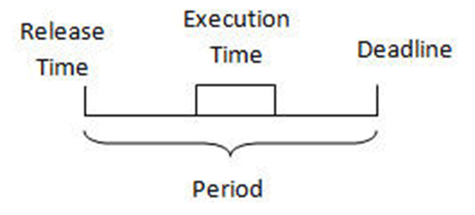
Context switching mechanisms
A context switch
  process switch or a task switch
  switching of the CPU from one process/task to another
  It is an essential feature of multitasking OS
How multitasking is working with single CPU?
A multitasking OS
      CPU simultaneously execute multiple tasks
      it is an illusion of concurrency
      It is achieved by means of context switching
Task: decomposed application into small, schedulable, and sequential program units
  governed by three time-critical properties;
    Release time
    Deadline
    Execution time

Slide 17
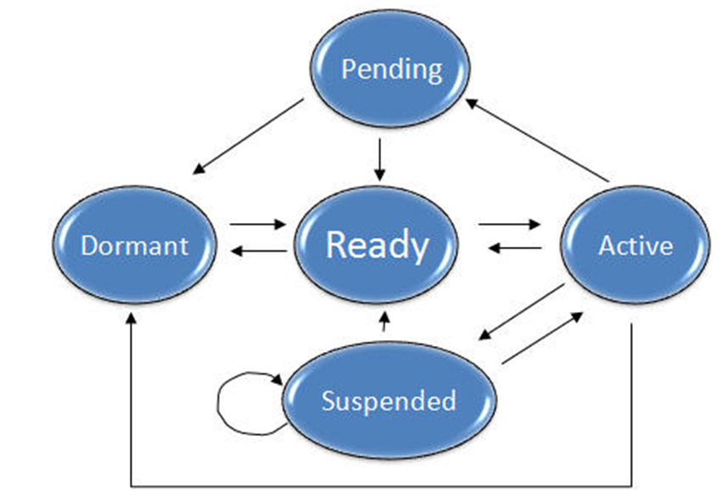
Cntd…
Each task may exist in following states
  Dormant: Task doesn’t require CPU time
  Ready: Task is ready to go active state, waiting processor time
  Active: Task is running
  Suspended: Task put on hold temporarily
  Pending: Task waiting for resource.

Slide 18
Cntd…
What happened during switching ?
  Context of the to-be-suspended task will be saved.
  Context of the to-be-executed task will be retrieved
Task Control block(TCB):
  Task uses TCBs to remember its context.
  Accessible only by RTOS
  Information on TCB could be
        Task_ID
        Task_State
        Task_Priority
        Task_Stack_Pointer
        Task_Prog _Counter

Slide 19
Inter-process communication
Tasks usually need to communicate and synchronize with each other for different reasons such as:
  Accessing a shared resource
  To signal the occurrence of events to each other
RTOS provides inbuilt inter-task primitives , which are kernel objects that facilitate these synchronization and communication.
Examples of such objects include:
  Semaphores
  Message queues
  Signal and so on

Slide 20
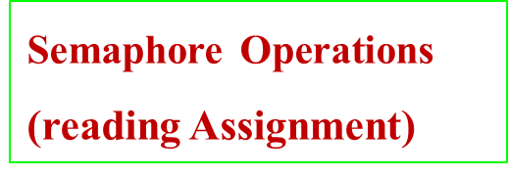
Cntd…
Semaphores is a kernel object that one or more tasks can acquire or release for :
  Mutual exclusion
  Signaling the occurrence of an event
  Synchronizing activities among tasks
Semaphores have
    An associated semaphore control block (SCB),
    A unique ID,
    A user-assigned value (binary or a count), and
    A task-waiting list.
There are two types
  Binary semaphores (0 or 1)
    If value =0 => semaphore is not available
    If value = 1 => semaphore available
  Counting semaphores (>= 0)
    uses a count to allow it to be acquired or released multiple times.

Slide 21
                Real time task scheduling
The two major groups are run-time and pre-run-time schedulers.
A. Run time Scheduler is referred to priority based schedulers where the decision of which task will execute next is computed dynamically at run time.
i. Priority-based Scheduling is based in the idea that each task in the systems is assigned a priority according to some decision base.
Consistent with priority, the task will be assigned for execution while the system is running.
The main question here is, which factor do we use to assign the priorities?
  priority-based algorithms, dynamic-priority and static-priority scheduling.
B. Pre-run-time schedulers are those which computation work about the execution line is done previous to run-time.
    These are also known as cyclic or clock driven schedulers.

Slide 22
          Cntd…
B. Cyclic scheduling (also known as clock-driven, pre-run time)
This schedule is computed off-line before the system begins to execute, and the computation is based on the knowledge of the release times and resource requirements of all the jobs for all times.
It offers, general advantages for deterministic systems, in which release times and job demands don’t vary or vary slightly with time.
But the problem is what happens with those systems in which the future work load is relatively unpredictable?
Scheduling policies: keeping record of the state of each task and allocates the CPU to one of them
Scheduler is responsible for time-sharing of CPU among tasks.

Slide 23
                Cntd…
More information about the tasks are required
  Number of tasks
  Resource Requirements
  Execution time
  Deadlines
Scheduling algorithms
  Clock Driven Scheduling
  Weighted Round Robin Scheduling
  Priority Scheduling
1. Clock Driven Scheduling
  All parameters about jobs (execution time/deadline) known in advance.
  Schedule can be computed at some regular time instances.
  Minimal runtime overhead
  Not suitable for many applications
  Time driven and for hard realtime system.

Slide 24
Cntd…
2. Weighted Round Robin Scheduling
  Jobs scheduled in FIFO manner
  Time quantum given to jobs is proportional to it’s weight
  Example use : High speed switching network : Job A can run only after Job B.
3. Priority Scheduling
  Processor never left idle when there are ready tasks
  Processor allocated to processes according to priorities.
  Priorities
    Static - at design time
    Dynamic - at runtime
  Earliest Deadline First (EDF
  Least Slack Time First (LSF): slack = relative deadline – execution left
  Rate Monotonic Scheduling (RMS): is an optimal fixed-priority policy where the higher the frequency (1/period) of a task, the higher is its priority.
    Tasks priority inversely proportional to it’s period.

Slide 25
Message passing and shared memory communications
Message Passing is a form of communication used in inter process communication.
  Communication is made by the sending of messages to recipients.
  Each process should be able to name the other processes.
  The producer typically uses send() system call to send messages,
  and the consumer uses receive() system call to receive messages.
  synchronous or asynchronous,
  Could either be between processes running on a single machine,
  Could be done over the networked machine.
Message Queue: kernels provide an object called a message queue
a buffer-like object through which tasks send and receive messages to communicate and synchronize with each others
Used to place task send or received messages

Slide 26
Cntd…
Message queues have
    an associated message queue control block (QCB),
    a name,
    a unique ID,
    memory buffers,
    a message queue length,
    a maximum message length,
Shared Memory communication
  Is an OS provided abstraction
  allows a memory region to be simultaneously accessed by multiple programs
  One process will create an area in RAM which other processes can access
  Since both processes can access the shared memory area like regular working memory, this is a very fast way of communication
  It is less powerful, as for example the communicating processes must be running on the same machine.

Slide 27
Dynamic allocation of tasks
Task in real time system, the system is subjected to real time.
  i.e, response should be guaranteed within a specified time constraint.
There are two types in real time systems task allocation: Periodic and dynamic allocation tasks.
Periodic tasks: jobs are release in at a regular interval and repeats itself after a fixed time interval.
Dynamic Tasks:
  It is a class of task allocation in which the task is a dynamic process and may need to be continuously adjusted in response to changes in the task environment.
  It is more efficient

Slide 28
Multi-tasking and Concurrency issue
Multitasking is the capability of the OS of running several applications at the same time.
When CPU resources are over-committed, the OS schedules the different active processes by performing a process switch at regular time intervals, distributing the available CPU cycles according to a well-defined priority policy.
Multitasking is the natural execution model of single or multiprocessor systems.
Switching among different processes naturally induces an execution overhead.
For a system to be real-time, there must be a guaranteed time frame where within a task must execute.
In a multitasking RTOS: the task scheduling, switching and execution elements are key to the effectiveness of the OS in real-time requirements.

Slide 29
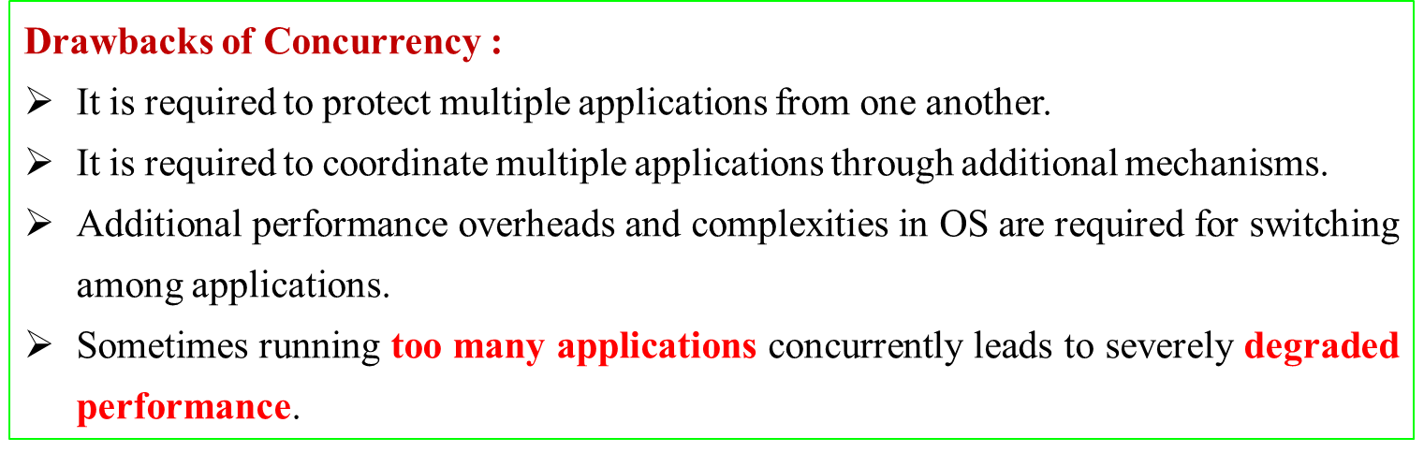
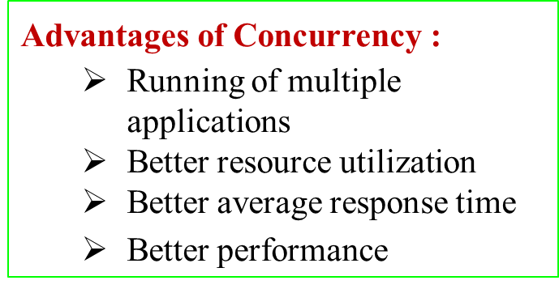
What is concurrency in real time systems?
Concurrency is the execution of the multiple instructions at the same time.
It happens in the OS when there are several process threads running in parallel.
The running process threads always communicate with each other through shared memory or message passing.
Concurrency in sharing of resources result in problems like deadlocks and resources starvation.

Slide 30
Fault tolerance
Fault tolerance refers to the ability of a system (computer, network, cloud cluster, etc.) to continue operating without interruption when one or more of its components fail.
Systems employ backup elements that take the place of the failed component to ensure there's no loss in productivity for your business.
Fault tolerance can be achieved by either hardware or software or time redundancy.
Safety-critical applications have strict time and cost constraints, which means that not only faults have to be tolerated but also the constraints should be satisfied.

Slide 31
Synchronization techniques: Centralized clock synchronization, Distributed clock synchronization
Distributed System is a collection of computers connected via the high speed communication network.
  In the distributed system, the hardware and software components communicate and coordinate their actions by message passing.
  Each node can share their resources with other nodes.
  So, there is need of proper allocation of resources to preserve the state of resources and help coordinate between the several processes.
  To resolve such conflicts, synchronization is used.
Synchronization in distributed systems is achieved via clocks.
  The physical clocks are used to adjust the time of nodes.
  Each node in the system can share its local time with other nodes in the system.

Slide 32
Cntd…
The time is set based on UTC (Universal Time Coordination).
UTC is used as a reference time clock for the nodes in the system.
There are 2 types of clock synchronization algorithms: Centralized and Distributed.
A. Centralized clock synchronization
It is the one in which a time server is used as a reference.
The single time server propagates its time to the nodes and all the nodes adjust the time accordingly.
It is dependent on single time server so if that node fails, the whole system will lose synchronization.
E.g., of centralized are-Passive Time Server, Active Time Server etc.

Slide 33
Cntd…
B. Distributed clock synchronization
It is the one in which there is no centralized time server present.
The nodes adjust their time by using their local time and then, taking the average of the differences of time with other nodes.
Distributed algorithms overcome the issue of centralized algorithms like the scalability and single point failure.
Examples of Distributed algorithms are:
    Global Averaging Algorithm,
    Localized Averaging Algorithm,
    NTP (Network time protocol) etc.

Slide 34
Handling resource sharing and dependencies: Priorities and reentrancy, Resource sharing protocols
Most the different task scheduling algorithms that the different tasks in a system are all independent.
  However, that is rarely the case in real-life applications.
Tasks often have explicit dependencies specified among themselves, however implicit dependencies are more common.
Tasks might become inter dependent for several reasons.
A common form of dependency arises when one task needs the results of another task to proceed with its computations.
Resource sharing protocols (Home work)

Slide 35
Cntd…
Some of the basic resource sharing protocols are
A. Priority Inheritance Protocol (PIP) is a technique which is used for sharing critical resources among different tasks.
This allows the sharing of critical resources among different tasks without the occurrence of unbounded priority inversions.
Basic Concept of PIP : is that when a task goes through priority inversion, the priority of the lower priority task which has the critical resource is increased by the priority inheritance mechanism.
It allows this task to use the critical resource as early as possible without going through the prevention.
It avoids the unbounded priority inversion.

Slide 36
Cntd…
B. Highest Locker Protocol (HLP) is a critical resource sharing protocol that is an extension of PIP.
It was introduced to overcome the limitations of PIP.
In this critical resource sharing protocol, every critical resource is assigned a ceiling priority value.
C. Priority Ceiling Protocol (PCP) is an extension of PIP and HLP.
It solves the problem of unbounded priority inversion of PIP, deadlock and chain blocking of HLP and also minimizes the inheritance-related inversion which was also a limitation of HLP.
It is not a greedy approach like PIP.
In PCP, it is possible that a task may be denied for access although the resources is free.

Slide 37
End of Chapter Three
Any Question???

